Slide 1
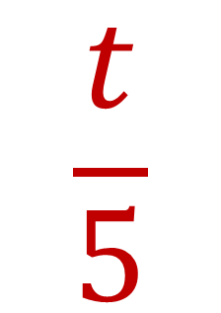








My Using
Letter Symbols Interactive
Notebook
$$×$$
$$\frac{1}{e}$$
$$a$$
$$3b$$
$$−$$
$$\frac{t}{5}$$
$$c$$
Name
Class
Teacher
Term 1 Semester 1
$$p^{2}$$
$$\sqrt{x}$$
1

Slide 2
Create your own front page
It needs to contain the following –
My number interactive notebook
Name
Class
Teachers Name
Semester 1 Term 1
Page number 1

Slide 3
Contents
Glossary or Formula Page
Page
Date
Description
2
3

Slide 4
Tasks
24
7
30
Essential Question
Questions
Notes
Summary
4
5

Slide 5
24
7
30
Date
Substitution
EQ – How do I evaluate an expression for the given variable?
How do I substitute?
Replace the variable (letter) in an expression with the given value and calculate
7

Slide 6
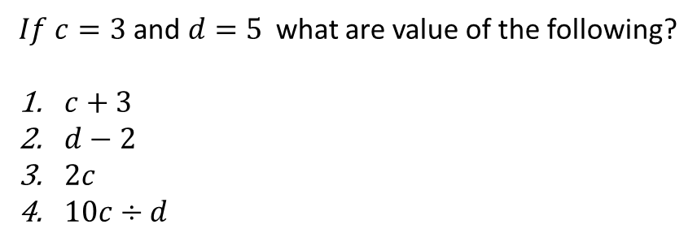
24
7
30
Date
Substitution
EQ – How do I evaluate an expression for the given variable?
How do I substitute?
Replace the variable (letter) in an expression with the given value and calculate
Example
$If c=3$and$d=5$ what are value of the following?
$c+3$
$d−2$
$2c$
$10c÷d$
7

Slide 7
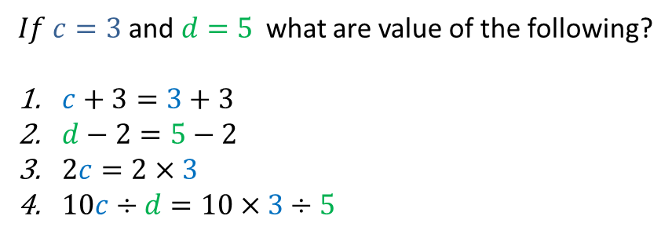
24
7
30
Date
Substitution
EQ – How do I evaluate an expression for the given variable?
How do I substitute?
Replace the variable (letter) in an expression with the given value and calculate
Example
$If c=3$and$d=5$ what are value of the following?
$c+3=3+3$
$d−2=5−2$
$2c=2×3$
$10c÷d=10×3÷5$
7

Slide 8
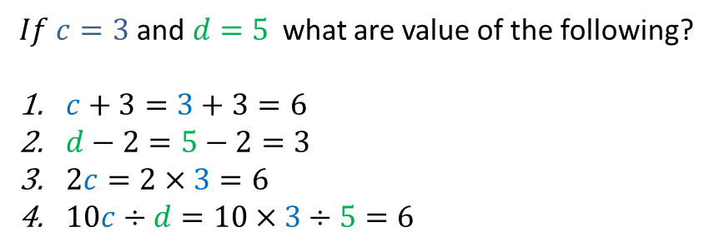
24
7
30
Date
Substitution
EQ – How do I evaluate an expression for the given variable?
How do I substitute?
Replace the variable (letter) in an expression with the given value and calculate
Example
$If c=3$and$d=5$ what are value of the following?
$c+3=3+3=6$
$d−2=5−2=3$
$2c=2×3=6$
$10c÷d=10×3÷5=6$
Page 91 Exercise – Write out question, show working out.
7

Slide 10
Notes Review
24, 7 ,30
Date
Title
Essential question
Notes complete
Notes complete with colour and diagrams
Questions completed
Contents page filed in
Formula page filled in

Slide 11
Homework
Review your notes and write a summary answering the essential question.

